Slide 1
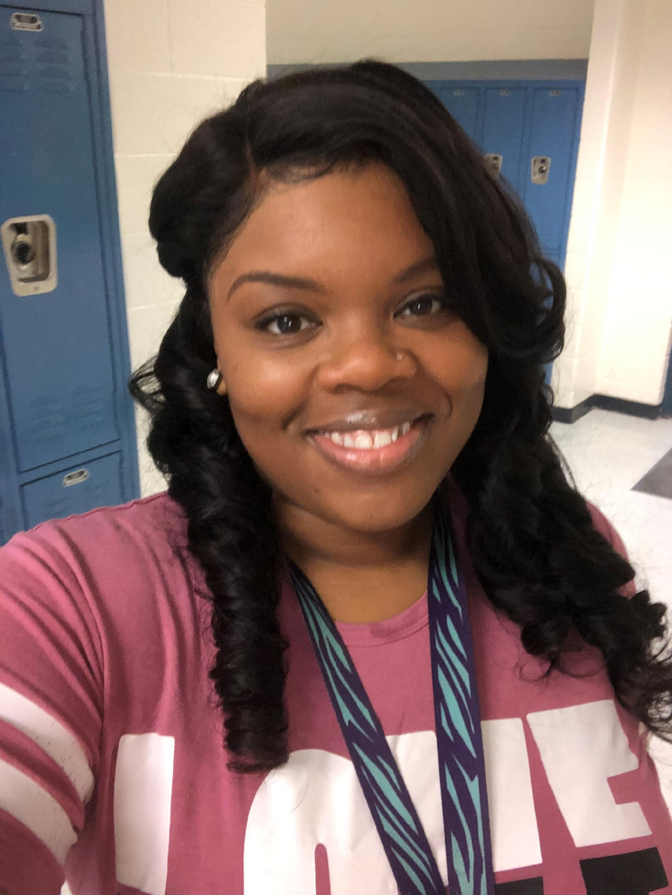

MS. B. BROWN 6TH-8TH GRADE TEACHER

Slide 2

MY CONTACT INFORMATION
Email
brownbr1@boe.richmond.k12.ga.us
Remind
https://www.remind.com/join/49h2bh
Website link
https://www.rcboe.org/Domain/16174
School Number
706-737-7288

Slide 3

DAILY SCHEDULE
1st Period- Morning Meeting/ELA- 9:30-11:05
2nd Period- Social Skills- 11:10-11:25
Lunch- 11:30-12:00
3rd Period- Connections Classes -12:55-2:05
4th Period- Math- 2:00-2:30
5th Period- Science- 2:45-3:00
6th Period- Social Studies- 3:00-3:15
7th Period- Functional/Life Skills- 3:20-3:45

Slide 4
CHECKOUT MY WEBSITE TO VIEW THE FOLLOWING INFORMATION
Month At A Glance (MAG)
Class Syllabus/Supply List
Resources
Additional Information

Slide 5
ARRIVAL AND DISMISSAL
Morning Arrival
Drop off your child on Dragons Way behind the school.
Morning Drop off time for car riders 8:30 a.m.
Early Drop off students are unsupervised. Please remain with your child until 8:30 a.m. when teachers report for duty.
Afternoon Dismissal
Bus riders will report to bus loading zone.
Walkers are dismissed form the bus loading zone where the crossing guard is located.
Car Riders pick up time 4:00 p.m.

Slide 6

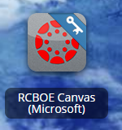
RCSS LEARNING PLATFORM AND CANVAS
New to the Richmond County School System
Go to rcboe.org
Click Student
Click Launch Pad
Your child will login through Launch Pad to access RCBOE Canvas.
Click link to watch Tutorial Video
https://www.rcboe.org/Domain/16265

Slide 7
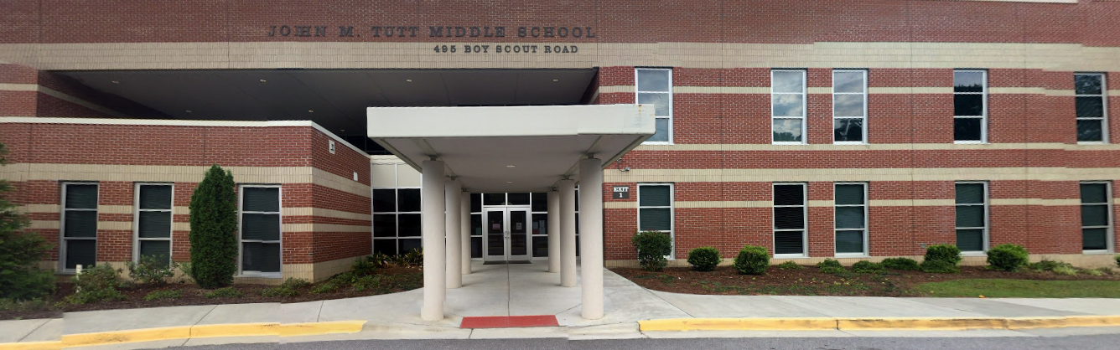
THANK YOU FOR VISITING JOHN M. TUTT MIDDLE SCHOOL OPEN HOUSE SEE YOU MONDAY, AIGUST 9TH

